Slide 1
SENTIMENT ANALYSIS ON TWITTER DATA
DEMONITISATION IN INDIA

Slide 2
WHAT IS SENTIMENT ANALYSIS
Sentiment analysis is contextual mining of text which identifies and extracts subjective information in source material, and helping a business to understand the social sentiment of their brand, product or service while monitoring online conversations.
A sentiment analysis system for text analysis combines natural language processing (NLP) and machine learning techniques to assign weighted sentiment scores to the entities, topics, themes and categories within a sentence or phrase
Sentiment analysis helps data analysts within large enterprises gauge public opinion, conduct nuanced market research, monitor brand and product reputation, and understand customer experiences.

Slide 3
APPLICATIONS
Finding hot keywords: Opinion mining can majorly help in discovering hot search keywords. This feature can help the brand in their SEO (Search Engine Optimization).
Voice of customer: Sentiment analysis of social media reviews, mentions and surveys help to broadcast the voice of customers to the brand, they are expressing their views about .The company can use this information in growing their market, advertisement targeting and building loyalty among its customers.
Better services: Text mining can provide a filter about, which service of the company is getting more negative feedback. This will help the company to know, what are the problems arising with that particular service. And based on this information the company can rectify these problems.
Get to know what’s trending: This will not only help the company to stay updated and connect more with the audience, but it will also facilitate the rise of new ideas, for developing new products. This will allow the company determine what the majority of the audience demands, and develop a product according to these demands.
Feedback on pilot releases and beta versions: When a company releases a new product or service, it is released as a pilot or beta version. The monitoring of public feedback at this stage is very crucial. So, text mining from social media platforms and review sections greatly helps accelerate this process.

Slide 4
Drawbacks of rules-based sentiment analysis
The simplicity of rules-based sentiment analysis makes it a good option for basic document-level sentiment scoring of predictable text documents, such as limited-scope survey responses. However, a purely rules-based sentiment analysis system has many drawbacks that negate most of these advantages. A rules-based system must contain a rule for every word combination in its sentiment library. Creating and maintaining these rules requires tedious manual labor. And in the end, strict rules can’t hope to keep up with the evolution of natural human language. Instant messaging has butchered the traditional rules of grammar, and no rule set can account for every abbreviation, acronym, double-meaning and misspelling that may appear in any given text document.
A rules-based system that fails to consider negations and intensifiers is inherently naïve, as we’ve seen.
A purely rules-based sentiment analysis system is very delicate. When something new pops up in a text document that the rules don’t account for, the system can’t assign a score. In some cases, the entire program will break down and require an engineer to painstakingly find and fix the problem with a new rule.

Slide 5
ABOUT THE PROJECT
Sentiment analysis on the topic “Demonetization in India” using twitter API and AFINN dictionary
The AFINN is a dictionary which consists of 2500 words which are rated from +5 to -5 depending on their meaning.
Generate a sentiment rating for each tweet. After that, perform the sentiment analysis by filtering out positive sentiment tweets from negative sentiment tweets.

Slide 6
STEPS
1. Register for twitter API
2. Install dependencies
3. Write our script
DEPENDENCIES USED
1. tweepy
2. matplotlib
3. numpy

Slide 7
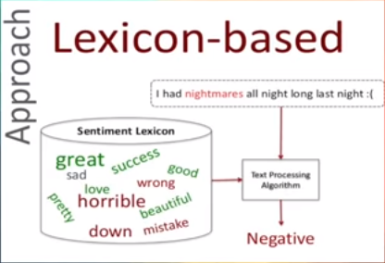
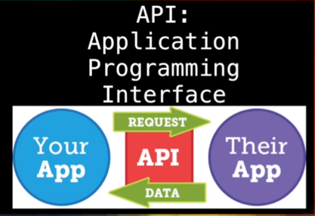
THE APPROACH
A lexicon based approach is a simple, viable and practical approach to
Sentiment Analysis of Twitter data without a need for training
machine learning model.

Slide 8
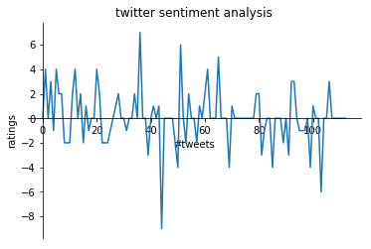
CONCLUSION
Percentage of positive tweets= 26.548672566371685
Percentage of negative tweets= 24.778761061946902
Percentage of neutral tweets= 48.67256637168141

